Slide 1
Update on Afinis Interoperability Standards
March 4, 2021
Kathy Levin, AAP
Nacha

Slide 2
What is An API?
Set of programming instructions
Allows one software application ask another to perform a task or a series of tasks
Always on and communicating real-time
Enables direct & real-time communication between back-office systems e.g., corporate-to-bank or bank-to-cloud ERP

Slide 3
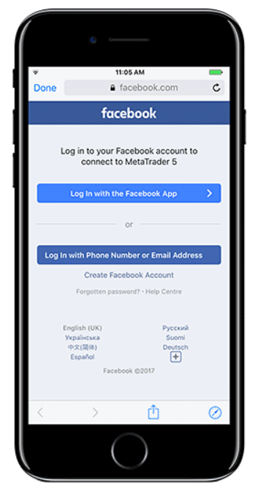
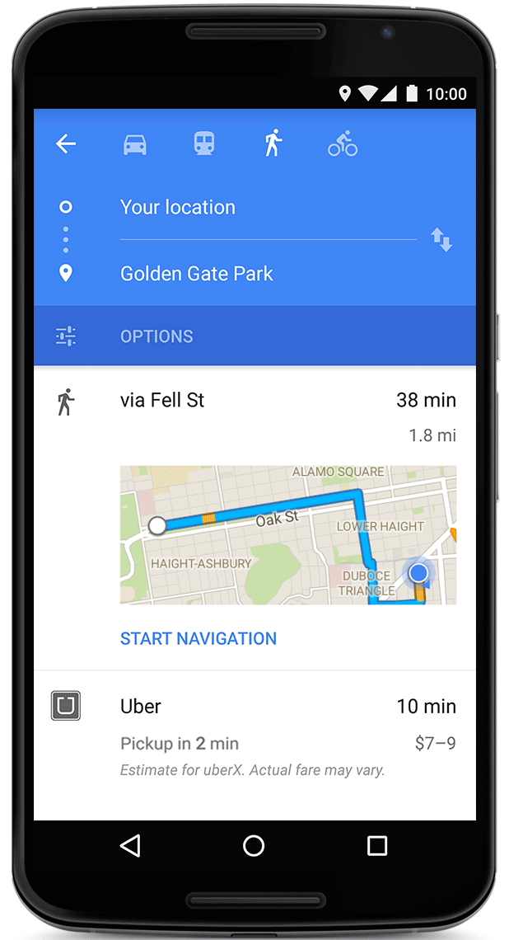
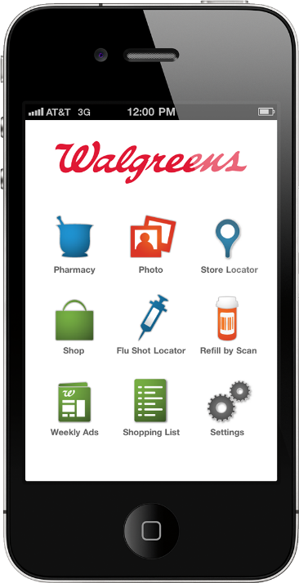
Examples of Popular APIs

Slide 4
Global Landscape

Slide 5
What Is Afinis Interoperability Standards?
In recognition of the increased interest and the role API standardization can play in enhancing support of the payments and business needs of the U.S. financial services industry, NACHA formed the API Standardization Industry Group (ASIG) in the spring of 2017.
Mission:
Afinis is a member-led organization established on behalf of the financial services industry by NACHA. NACHA unites diverse stakeholders to develop rules and standards that foster compatibility and integration across the financial services ecosystem. Afinis members share a single vision: to improve and support efficiency, safety, and interoperability for all financial services participants by developing and promoting adoption of implementable and open API and financial services messaging standards.

Slide 6
Afinis Members
Accredited Standards Committee X9 | Fiserv | Metrobank
ACI Worldwide | FRB Atlanta | MicroBilt Corporation
Alkami Technology, Inc. | FRB Boston | Moov
Bank of America | FRB Chicago | Nacha
Banker's Bank | FRB Cleveland | Navy Federal Credit Union
Barclays | FRB Dallas | NCR
BNY Mellon | FRB Kansas City | NEACH
Bottomline Technologies | FRB Minneapolis | Oracle
Citi | FRB New York | Payments Canada
City National Bank | FRB Philadelphia | Payrailz
Citizens Bank | FRB Richmond | Pelican
Commerce Bank | FRB San Francisco | PNC Bank
Community America Credit Union | FRB St. Louis | SHAZAM
Computer Services, Inc. | Hitachi | Tata Consultancy Services
CUFX | ICBA | TD Bank
Deutsche Bank | INMAR Intelligence | Truist
Diebold Nixdorf | Interdigital Software | U.S. Bank
Discover Financial Services, Inc. | J.P. Morgan Chase | Webster Bank
EPCOR | MACHA | Wells Fargo
Ernst & Young | Mastercard | XMLdation

Slide 7
Afinis API Open Standards
Afinis develops implementable API products for adoption by the financial services industry
Open API’s are developed using open source tools
Jira/Conflunce
Github
Swagger 2.0
Open API’s are developed using ISO20022 message definitions combined with Afinis data models
Afinis.org houses the API standards and Afinis partnered with XMLdation to enable the industry to leverage the Finland-based company’s testing capabilities within the Afinis developer portal.

Slide 8
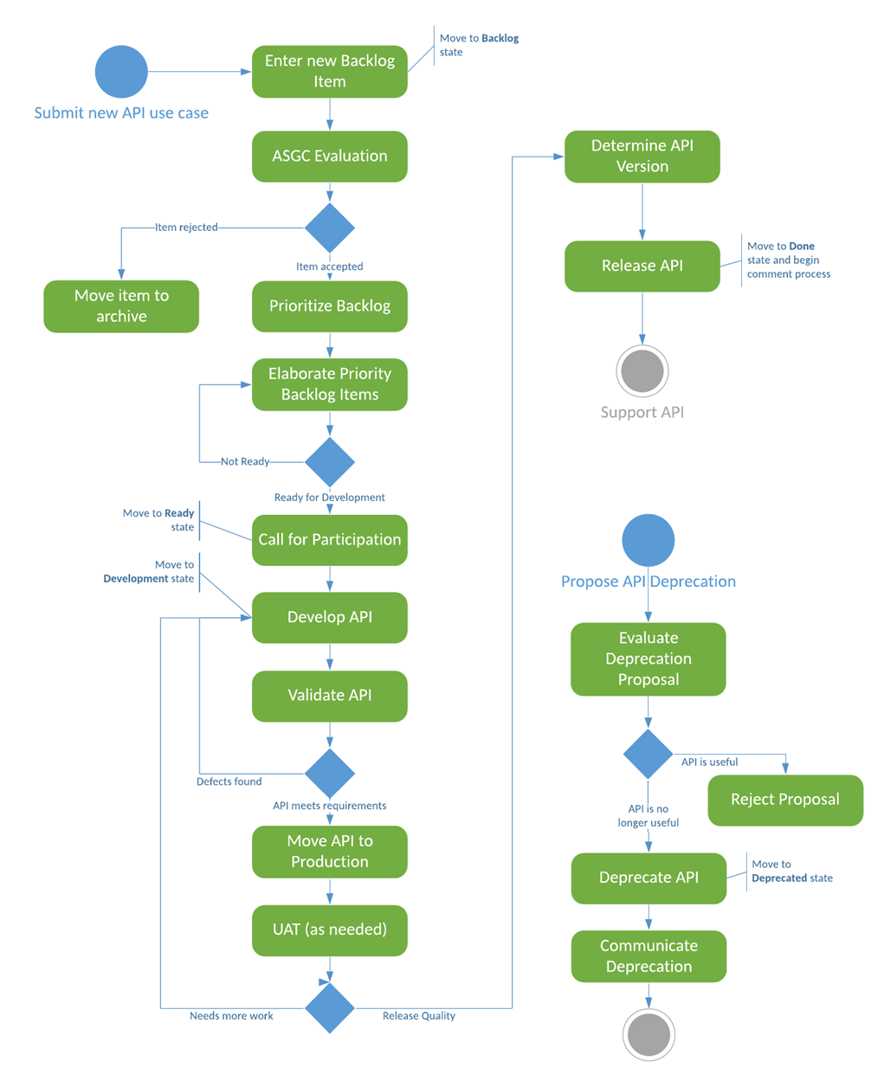
Afinis API Development Process Workflow

Slide 9
Afinis Standards Governance Committee (ASGC)
The Governance Committee is chartered to:
Evaluate newly submitted API Requests / Ideas
Maintain & Prioritize the Backlog of APIs
Shepherd the initial stages of API definition (Epic, user stories)
Approve API Readiness for Calls for Participation
The Governance Committee consists of individuals representing financial institutions, solution providers, consulting firms, standards organizations and payment associations and is currently led by:
Chair: Christina McGeorge, NCR
Vice Chair: David Barrick, Truist

Slide 10
Published Open API Standards
Get Bank Contact Information - allows originating financial institutions to quickly alert receiving financial institutions of potential fraud
Account Validation - ensures target accounts are valid and able to accept electronic payments.
Payment Initiation - provides payment originators with a standardized way to submit ACH payment instructions.
Transaction Status - provides payment originators with transaction status via real-time messages.

Slide 11
Published Open API Standards
Billing Account Number Validation - allows a bill pay provider to do a real-time validation of consumer-entered account numbers with the billers directly.
Payee Profile - allows businesses to obtain a participant’s payment profile
Request to Pay - enables a biller to route billing information electronically to any payer through any network
Bank Contact v2 - allows a financial institution to input and receive contact data from the NACHA contact registry

Slide 12
Currently in Development
Get Corporate Account Balances
Get Corporate Transaction History
Get Corporate Transaction Detail
Request Copy of ACH Written Statement of Unauthorized Debit
Authorize to Initiate Payment

Slide 13
Upcoming APIs
PI Planning held February 10 to approve new APIs
Add Name to Account Validation API
Request Proof of ACH Authorization
Current Afinis Backlog
Account Validation for Government Disbursements
Initiate Wire Transfer Payment
Manage Accounts (EBAM)
Update Auto Pay

Slide 14
Afinis in the Marketplace
Financial Institutions
Phixius

Slide 15
Phixius: Interoperable Payment Information Exchange
Standardized
Secure
Shared set of rules and common APIs facilitate easy adoption and interoperability
Trusted
Data and authenticity are ensured using transport layer security, private certificates, and message signing
Accuracy of all data exchanged via API can be validated on Phixius
Customer A
CSP A
CSP B
Customer B
Authenticated
Auditable
Each participant is vetted and authorized by Nacha as a validated credential service provider (CSP) and governed by Nacha created rules
Private
Metadata is logged to track events and changes to permissions
Each participant can only see interactions and information that is relevant and permissioned to them, and there is no central data store

Slide 16
Phixius Data Exchange and Verification flow
“Phixus users exchange or validate information without centralization ”
(2) Queries for supplier/biller/business availability and permission to get or verify data
(1) Makes business discoverable with permission and hashes sensitive data for comparison in step 3
Business Originating Payments
Business Receiving Payments
Requesting CSP
Responding CSP
Or
Or
(3) If approved - provides or verifies requested data via standardized API
CSP Operations
CSP Operations

Slide 17
Afinis in the Marketplace
Adoption is accelerating
Afinis APIs being adopted by Financial Institutions, Financial Services Providers, Fintech, and Payment Networks
Afinis is continuing the feedback loop

Slide 18
Questions?

