Slide 1
BTRS Implementation Approach for The Clearing House - Real-time Payments Updated: August 24, 2017
David Repking ASC X9C1-1 Chair of the BTRS Committee
Copyright © 2017 Accredited Standards Committee X9, Inc. All rights reserved.

Slide 2
Objectives
BTRS – Impact of The Clearing House Real Time Payments
This session will:
Review the history and key elements of RTP
Possibly finalize the Code Assignment to support RTP
Determine if RTP Transaction Text should be standardized, too
Determine next steps
Collaboration Across Standards Organizations:
The Clearing House Steve Ledford
CGI Isabelle Bouille (SWIFT) & Neil Clarke (Volante Tech)
ASC X9C1-1 Mary Hughes (FRB Minneapolis) & David Repking (JPMorgan)
Background
X9 recently received a request to add Real Time Payment codes to the X9.121 Balance Transaction and Reporting Standard (BTRS). The BTRS code list adapts to the changing global financial environment so account statement reporting can reflect current transactions. The X9C1 BTRS subgroup of the X9C Corporate Banking Subcommittee is responsible for maintaining the BTRS and issuing new codes. Specifically, the group X9C1-1 Code List Update group is the body tasked with evaluating and developing new Real Time Payment Codes in response to this request
Copyright © 2017 Accredited Standards Committee X9, Inc. All rights reserved.

Slide 3
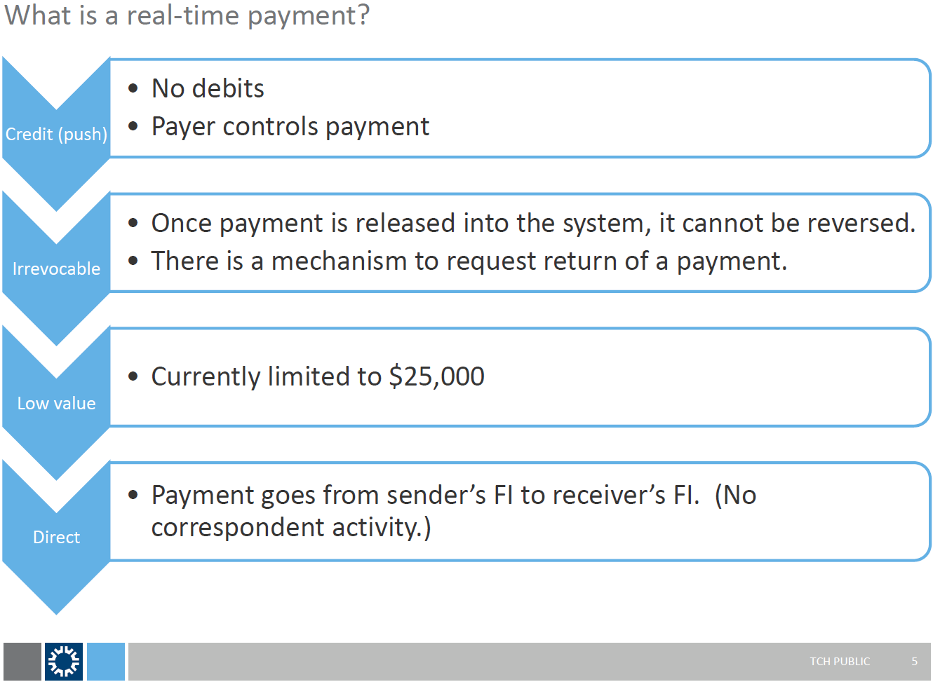
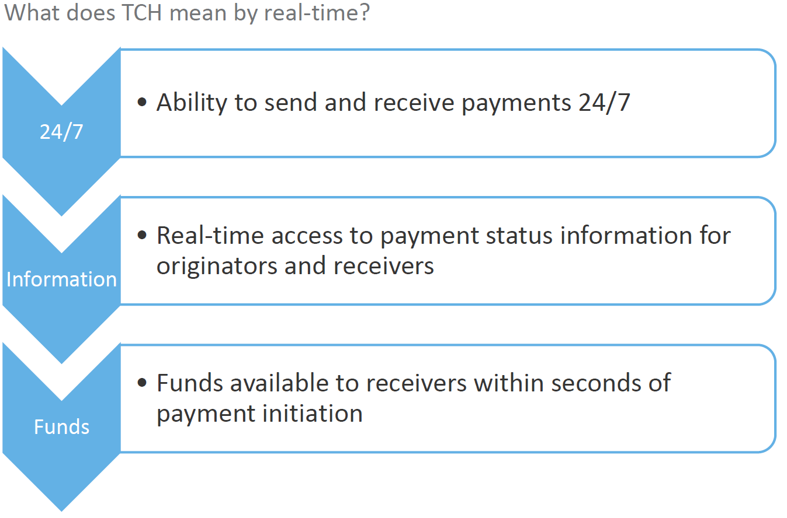
TCH Introduction of Real-time Payments
Summary
Will be introduced within months (date TBD?)
Participants must be approved by TCH
Participants determine which of their customers they will provide RTP services to
Information From: Industry Briefing Webinar: RTP Legal Framework
For more information visit:
https://www.theclearinghouse.org/payments/real-time-payments
Copyright © 2017 Accredited Standards Committee X9, Inc. All rights reserved.

Slide 4
Key Elements of the BTRS Support of Money Transfers Example: Wire and ACH Detail Codes
BTRS supports both low- and high-dollar transfers
RTP is most like Money Transfers
Interoperability with ISO and SWIFT is key: Goal is to define one global transaction set to support RTP
Type | Detail Code | Summary Code | Detail Code Description | Summary Code Description | ISO Domain | ISO Family | ISO Sub-Family | SWIFT
CR | 195 | 190 | Money Transfer | Total Incoming Money Transfers | PMNT | RCDT | DMCT | TRF
CR | 206 | 190 | Money Transfer - Book | Total Incoming Money Transfers | PMNT | RCDT | BOOK | TRF
CR | 208 | 207 | Money Transfer - Cross-Border | Total International Money Transfer Credits | PMNT | RCDT | XBCT | TRF
CR | 214 | 210 | Money Transfer - Foreign Exchange | Total International Credits | PMNT | RCDT | FXCT | FEX
DB | 495 | 490 | Money Transfer | Total Outgoing Money Transfers | PMNT | ICDT | DMCT | TRF
DB | 506 | 490 | Money Transfer - Book | Total Outgoing Money Transfers | PMNT | ICDT | BOOK | TRF
DB | 508 | 507 | Money Transfer - Cross-Border | Total International Money Transfer Debits | PMNT | ICDT | XBCT | TRF
DB | 514 | 510 | Money Transfer - Foreign Exchange | Total International Debits | PMNT | ICDT | FXCT | FEX
Type | Detail Code | Summary Code | Detail Code Description | Summary Code Description | ISO Domain | ISO Family | ISO Sub-Family | SWIFT
CR | 165 | 140 | ACH Received | Total ACH Credits | PMNT | RCDT | ACDT | TRF
CR | 166 | 167 | ACH Originated Settlement | Total ACH Settlement Credits | PMNT | IDDT | ASET | TRF
CR | 168 | 167 | ACH Originated Settlement - Return | Total ACH Settlement Credits | PMNT | ICDT | ARET | RTI
CR | 169 | 140 | ACH Miscellaneous | Total ACH Credits | PMNT | IDDT | ATXN | TRF
CR | 257 | 256 | ACH Received - Return | Total ACH Return Items | PMNT | RCDT | ARET | RTI
DB | 455 | 450 | ACH Received | Total ACH Debits | PMNT | RCDT | ADBT | DDT
DB | 466 | 467 | ACH Originated Settlement | Total ACH Settlement Debits | PMNT | ICDT | ASET | DDT
DB | 468 | 467 | ACH Originated Settlement - Return | Total ACH Settlement Debits | PMNT | IDDT | ARET | RTI
DB | 469 | 450 | ACH Miscellaneous | Total ACH Debits | PMNT | ICDT | ATXN | DDT
DB | 557 | 556 | ACH Received - Return | Total ACH Return Items | PMNT | RCDT | ARET | RTI
Copyright © 2017 Accredited Standards Committee X9, Inc. All rights reserved.

Slide 5
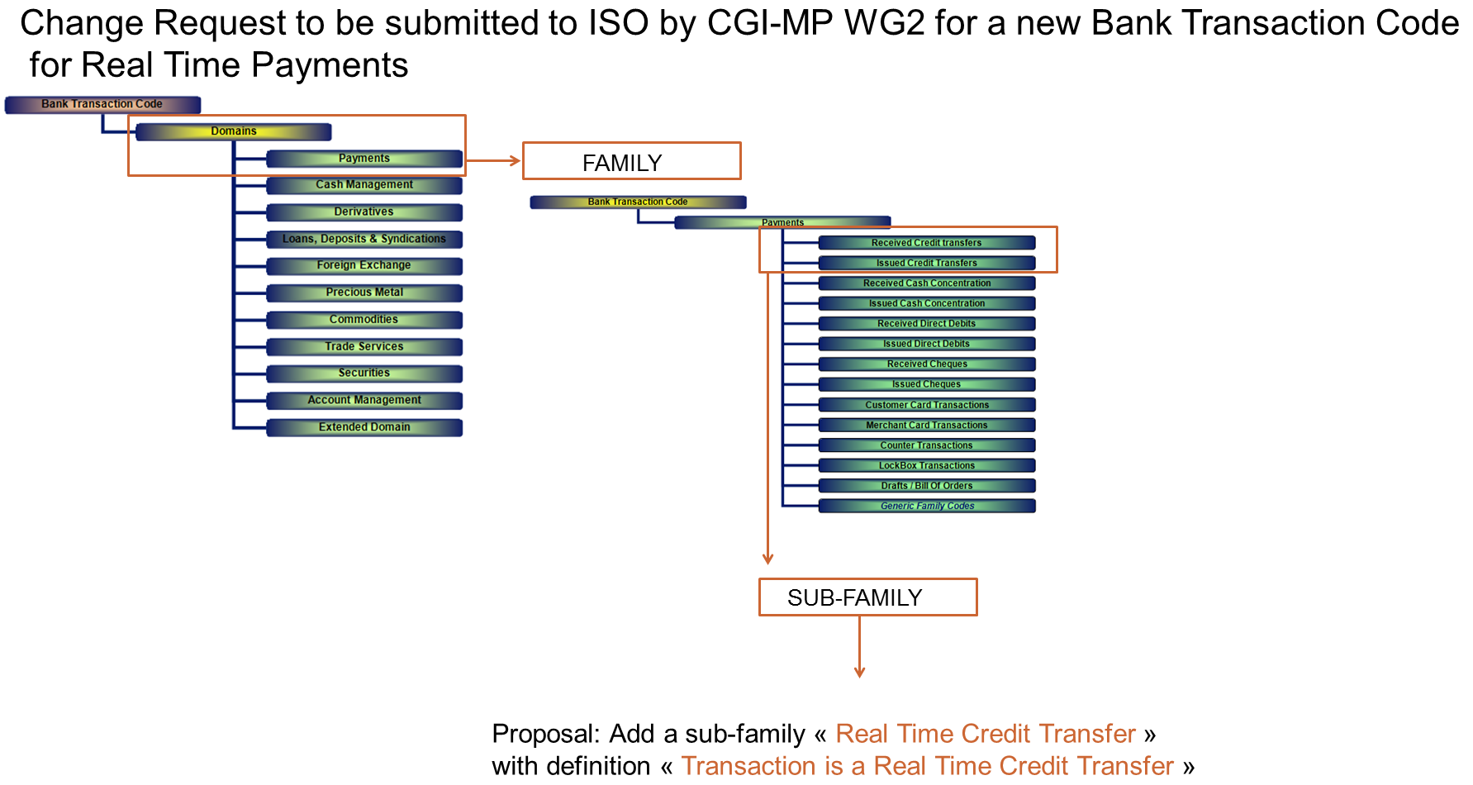
CGI Approach to Add ISO 20022 ISO Codes Isabelle Bouille (SWIFT) & Neil Clarke (Volante Tech)
Copyright © 2017 Accredited Standards Committee X9, Inc. All rights reserved.

Slide 6
Initiating BTRS Action to Support RTP
To begin the process, Steve Ledford of The Clearing House used the X9.org website to propose the following codes:
Justification
Real-time or immediate payment systems have been deployed in several countries and will soon be launched in the US (RTP), the Euro Zone (SEPA SCT inst) and Australia (NPP). The characteristics of these payments are distinct from those of ACH transactions or wire transfers, primarily because they entail immediate notification to the sending and receiving parties and immediate application of funds. Existing codes do not address this type of transfer.
ProposedTransactionName | ProposedTransactionDescription | CodeType
Summary Real Time Credits Received | Transactions are Real Time Credits Received | Credit Summary – Record 03
Summary Real Time Credits Sent | Transactions are Real Time Credits Sent | Debit Summary - Record 03
Real Time Credit Transfer Received | Transaction is a Real Time Credit Transfer | Credit Detail - Record 16
Real Time Credit Transfer Sent | Transaction is a Real-Time Credit Transfer | Debit Detail - Record 16
Copyright © 2017 Accredited Standards Committee X9, Inc. All rights reserved.

Slide 7
BTRS Proposal to Support RTP Transactions
A outside subcommittee met to help craft this proposal.
Banks are pushing to finalize the RTP design!
Selected new codes (like SEPA and email, we did not repurpose codes)
Publish for both BAI2 and BTR3
Create 2 Detail Codes: RRCP = Received Real-time Credit Transfer DMCT - Domestic Credit Transfer
IRCP = Issued Real-time Credit Transfer
Type | Detail Code | Summary Code | Detail Code Description | Summary Code Description | ISO Domain | ISO Family | ISO Sub-Family | SWIFT
CR | 158 | 159 | Real Time Payment | Total Real Time Payment Credits | PMNT | RRCT | DMCT | TRF
DR | 458 | 459 | Real Time Payment | Total Real Time Payment Debits | PMNT | IRCT | DMCT | TRF
Create 2 Summary Codes:
Subcommittee: Garret Rogers (PNC), Janet Busch (X9), Steve Stevens (X9), Steve Ledford (TCH), Mary Hughes (X9), John Humphreys (BYNM), Bill Golembiewski (BYNM), Paul Trozzo (PNC), Jim Colassano (TCH), David Repking (JPM), Carl Slabicki (BYNM), Vince Galloni (BYNM)
SummaryCode | Description
159 | Total Real Time Payment Credits
459 | Total Real Time Payment Debits
Copyright © 2017 Accredited Standards Committee X9, Inc. All rights reserved.

Slide 8
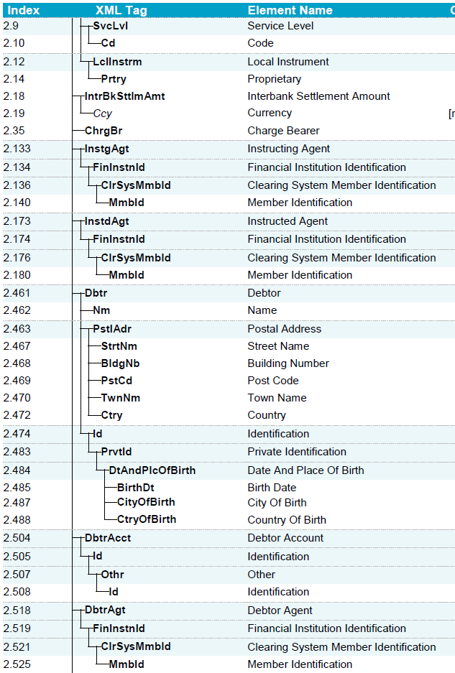
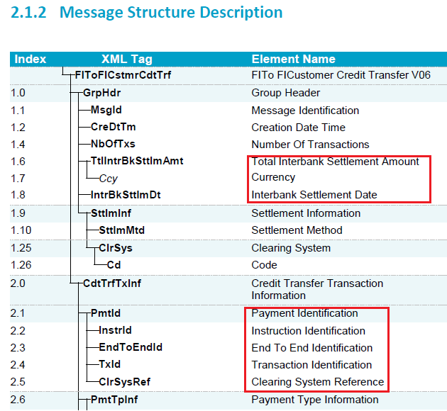
BTRS Approach for Transaction Text (Record 88)
Another consideration is to produce an industry standard for RTP format within the BTRS Standard, which would conform to CGI. We should look to recommend a ‘best practice’ for the Record 88 text.
X9 will follow the CGI Lead for ISO camt.054
Copyright © 2017 Accredited Standards Committee X9, Inc. All rights reserved.

Slide 9
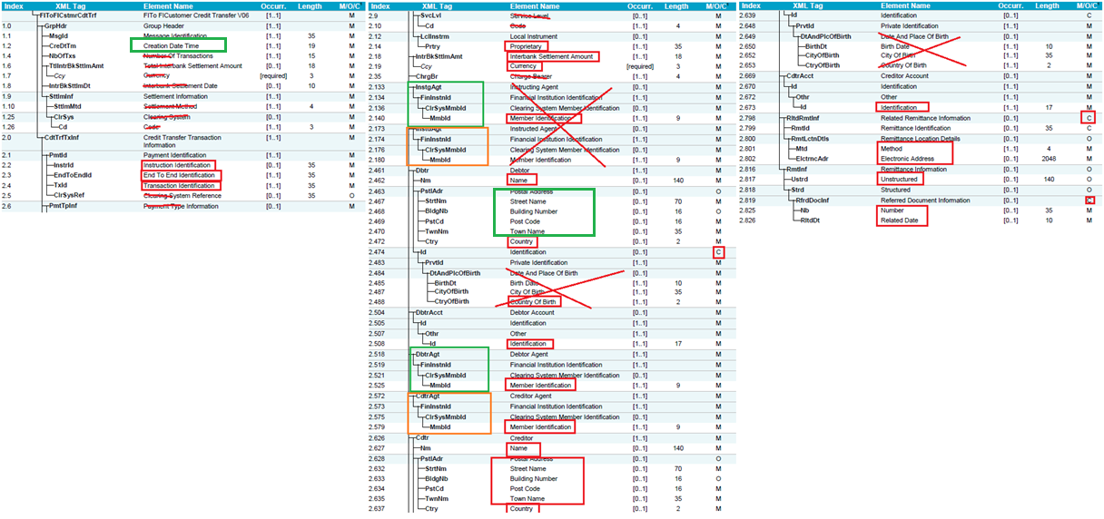
BTRS Approach for Transaction Text (Record 88)
Draft Worksheet to Identify Key Information Reporting Elements
April 20 – Added the fields in green boxes
1.1 - Message ID - created by the debtor's bank, unique for each message between parties, while the Instruction ID is the unique reference number for each completed credit transfer
1.4 - Number of Transactions always 1
1.4 and 1.6 - always equal (since 1 payment per message) - Use 2.18 for Amount
2.3 - End to End ID - can be used for Invoice Number
2.140 - Bank ID of originating account = 2.525
Instructing Agent (2.133) = Crediting Agent (2.518)
Instructed Agent (2.173) = Creditor Agent (2.572)
2.508 - account number
2.798/9 - conditional if there is an associated remittance message
2.825/6 - Request for Return of funds (original ID)
Copyright © 2017 Accredited Standards Committee X9, Inc. All rights reserved.

Slide 10
BTRS Approach for Transaction Text (Record 88)
Final - Key Information Reporting Elements
ISO pacs.008 Msg # | Field Name | Field Description | RTP Status | Length | BTRS Field Name | Comments
1.2 | CreDtTm | Creation Date Time | M | 19 | Created | ISO Definition: Date and time at which the message was created. The date is required to be set to Eastern Time (ET). Format - YYYY-MM-DDThh:mm:ss Best Practice: Report the Created Date/Time, but banks may instead choose to include: ACK/Confirmation -OR- Memo-posted. (Note: The current day and prior day Date/Time may also vary based on information available to the bank)
2.2 | InstrId | Instruction Identification | M | 35 | Debtor Bank Ref | ISO Definition: Unique identification, as assigned by an instructing party for an instructed party, to unambiguously identify the instruction. Format = YYYYMMDDbbbbbbbbbbbXAAAAnnnnnnnnnnn Will help identify the transaction when researching with associated bank. If a bank needs to limit space on the BAI2/BTRS, then okay to report only the last 11 digits. Bank-to-Bank communication may only need to report the last 11 digits, but full string reported.
2.3 | EndToEndId | End To End Identification | M | 35 | Debtor Client Ref | ISO Definition: Unique identification, as assigned by the initiating party, to unambiguously identify the transaction. This identification is passed on, unchanged, throughout the entire end-to-end chain. Will contain information from the sending client, often important for reconcilement. Might be blank, recommendation from TCH is to insert "NOREF". Best Practice: Include as the Customer Reference (Entered by originating client) On Record 16 - display up to 'rightmost' 16 significant characters in Customer Reference field -On Record 88 - display the entire field
2.4 | TxId | Transaction Identification | M | 35 | Debtor Trans ID | ISO Definition: Unique identification, as assigned by the first instructing agent, to unambiguously identify the transaction that is passed on, unchanged, throughout the entire interbank chain. Best Practice: Do not include in Record 88 if the value is the same as Instruction Identification (field 2.2)
2.462 | Nm | Name | M | 140 | Debtor Name | Best Practice: If the BAI2/BTRS recipient is the Debtor, okay if a bank does not report all/certain Debtor fields.
2.508 | Id | Identification | M | 17 | Debtor Acct | Best Practice: If this is 'your' bank, not required to report
2.525 | Mmbld | Member Identification | M | 9 | Debtor Bank ID | Best Practice: If this is 'your' bank, not required to report
not on pacs.008 |  | Member Name |  |  | Debtor Bank | Note: Some banks include the bank name, so this field provides that option to report the name associated to the ABA from Mmbld (2.525) using the bank's own Bank Table Best Practice: If this is 'your' bank, not required to report it
2.463 | PstlAdr | Postal Address |  |  | Debtor Address | Debtor Address - concatenate the fields up to all 5 fields Best Practice: If this is 'your' bank, not required to report
2.467 | StrtNm | Street Name | O | 70
2.468 | BldgNb | Building Number | O | 16
2.470 | TwnNm | Town Name | O | 35
2.469 | PstCd | Post Code | O | 16
2.472 | Ctry | Country | O | 2
2.627 | Nm | Name | M | 140 |  | Best Practice: If the BAI2/BTRS recipient is the Creditor, okay if a bank does not report all/certain Creditor fields.
2.673 | Id | Identification | M | 17 | Creditor Acct | Best Practice: If this is 'your' bank, not required to report
2.579 | Mmbld | Member Identification | M | 9 | Creditor Bank ID | Best Practice: If this is 'your' bank, not required to report
not on pacs.008 |  | Member Name |  |  | Creditor Bank | Note: Some banks include the bank name, so this field provides that option to report the name associated to the ABA from Mmbld (2.579) using the bank's own Bank Table Best Practice: If this is 'your' bank, not required to report it
2.628 | PstlAdr | Postal Address |  |  | Creditor Address | `
2.632 | StrtNm | Street Name | O | 70
2.633 | BldgNb | Building Number | O | 16
2.635 | TwnNm | Town Name | O | 35
2.634 | PstCd | Post Code | O | 16
2.637 | Ctry | Country | O | 2
2.799 | Rmtid | Remittance Identification | C | 35 | Remit ID | ISO Definition: Unique identification, as assigned by the initiating party, to unambiguously identify the remittance information sent separately from the payment instruction, such as a remittance advice. NOTE: Remittance is Optional and may conform to a bank's policy on ACH Addenda and/or Wire ERI
2.801 | Mtd | Method | C/M | 4 | Remit Method | ISO Definition: Method used to deliver the remittance advice information. Value informs whether the Electronic Address is EMAIL or URID (Uniform Resource Identifier) e.g., URLs, email addresses, and ftp sites.
2.802 | ElctrncAdr | Electronic Address | C/M | 2048 | Remit Address | ISO Definition: Electronic address to which an agent is to send the remittance information.
2.817 | Ustrd | Unstructured | O | 140 | Remit Ustrd | ISO Definition: Information supplied to enable the matching/reconciliation of an entry with the items that the payment is intended to settle, such as commercial invoices in an accounts' receivable system, in an unstructured form.
2.825 | Nb | Number | C/M | 35 | Remit Nb | ISO Definition: Unique and unambiguous identification of the referred document. This is the Instrid (2.2) of the original payment
2.826 | RltdDt | Related Date | C/M | 10 | Remit Related Date | ISO Definition: Date associated with the referred document. This is the date of the original payment.
The fields from ISO pacs.008 were analyzed and these elements were determined to best represent core information reporting on BTRS.
Reference
Debtor
Creditor
Remittance
This provides payment lifecycle mapping from Payment to Reporting.
It will aid you in extracting core information from the RTP that is standard in reporting and reconcilement processes.
Each financial institution and treasury workstation provider is encouraged to follow these best practices, but it is understood that adhering to existing conventions provides consistency which users also value – so, there may be some variation
Copyright © 2017 Accredited Standards Committee X9, Inc. All rights reserved.

Slide 11
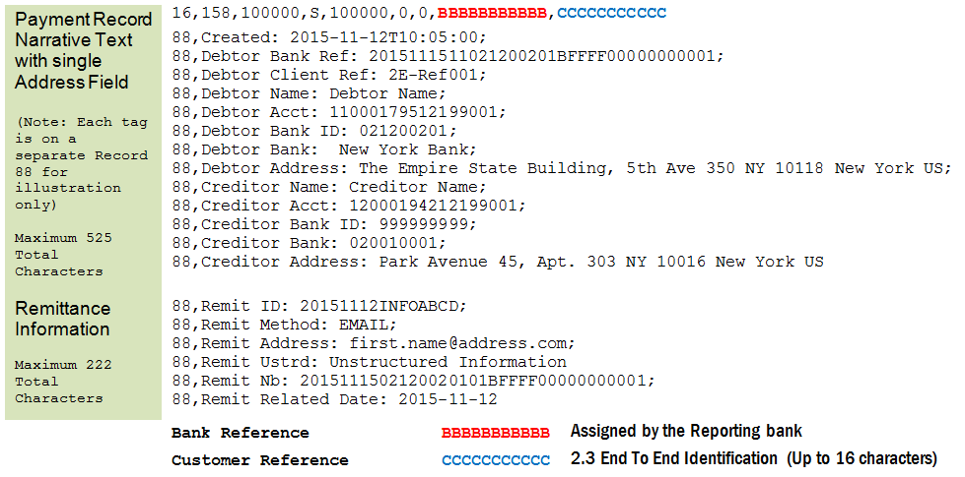
BTRS Approach for Transaction Text (Record 88)
Final - Key Information Reporting Format on BTRS or BAI2
The new format includes Debtor, Creditor, and Remittance information from the originating party.
Since this information travels with the payment through the clearing system between banks, it becomes directly available to Information Reporting platforms.
The goal of publishing this standard is to help prevent variations that may arise between financial institutions that companies with multiple bank relationships would otherwise need to normalize themselves.
So, implementing this format accomplishes this goal.
Copyright © 2017 Accredited Standards Committee X9, Inc. All rights reserved.

Slide 12
Project Steps
For updates, visit: http://x9.org/standards/btrs/
X9 Approval Process COMPLETE:
ASC X9C1-1 Committee Approval (that is us!)
X9 Approval
ANSI Approval
To implement RTP at a Bank:
The Payment System should determine whether to define RTP transactions uniquely
If so, the new DDA Trancodes are required
New DDA Trancodes will map to the new BTRS Detail Codes 158 & 458
Some DDA Systems require all codes to have associated Reversal Codes – these can map to 158 & 458
THEN – Define the new codes in the BTRS and BAI2 Tables
Client Communication so they can prepare their systems for the new codes
Also – Promotional Opportunities across the Standards committees and TCH
To implement RTP on a Treasury Workstation:
Define the new codes in the BTRS and/or BAI2 Table
Process as Money Transfers
Copyright © 2017 Accredited Standards Committee X9, Inc. All rights reserved.

