Slide 1
Blockchain Mechanics
Terence Spies
Crypto Geek
HPE

Slide 2
Goals
Get to a technical understanding of:
  Blockchains
  Bitcoin
  Smart contracts
Why they are important and how cryptography enables these mechanisms
Note: This will be somewhat BTC heavy, but most rules apply to private chains.

Slide 3
What do blockchains replace?
Access protected writes to an authoritative database
Transactions, timestamping, contracts, etc.
Database
Validation Rules
Client
Client
Client
Client

Slide 4
What do blockchains replace?
Authoritative access control replaced with distributed consensus
Database state dependent upon majority agreement of update validity
Database
Validator
Validator
Validator
Client
Client
Client
Client

Slide 5
Why?
Authority seems to work pretty well
Distributed consensus can allow:
  Distrustful parties to maintain clean state
  Completely unambiguous rules about validity
  Removing authentication and identity as essential
  Perhaps solves other problems also….

Slide 6
Welcome to Cryptoland
Ugh. Do I have to learn all this detail?
Yes. The laws of crypto are the laws of blockchains and bitcoin. Not understanding this will lead to bad intuitions about what this stuff can and cannot do.
Luckily, only need to understand two laws of cryptography (and believe that people are motivated by incentives, I guess)
We’ll do this by building increasingly complex games that simulate parts of bitcoin and blockchains.

Slide 7
Ingredient #1: Hashes
A hash function (like SHA-256) takes a block of data in, and produces an effectively random fixed size integer.
Any change to the input randomizes it
“The quick brown fox did some crypto”
“The quick brown Fox did some crypto”
SHA-256
SHA-256
410312395834291203…
983249120432492340…

Slide 8
Hash-based Proof of Work
Can’t compute an input from an output
To find a hash with N zeros at the start of the input, requires 2^{N} computations…proves computational work
If we hash an incrementing “nonce” as the hash input, we can go looking for zeros:
in 3e-05 seconds, nonce = 0 yielded 0 zeros. value = 4c8f1205f49e70248939df9c7b704ace62c2245aba9e81641edf…
in 0.000138 seconds, nonce = 12 yielded 1 zeros. value = 05017256be77ad2985b36e75e486af325a620a9f29c54…
in 0.000482 seconds, nonce = 112 yielded 2 zeros. value = 00ae7e0956382f55567d0ed9311cfd41dd2cf5f0a7137…
in 0.014505 seconds, nonce = 3728 yielded 3 zeros. value = 000b5a6cfc0f076cd81ed3a60682063887cf055e47b…
in 0.595024 seconds, nonce = 181747 yielded 4 zeros. value = 0000af058b74703b55e27437b89b1ebcc46f45ce55d6….
in 3.491151 seconds, nonce = 1037701 yielded 5 zeros. value = 00000e55bd0d2027f3024c378e0cc511548c94fbeed0e….
in 32.006105 seconds, nonce = 9913520 yielded 6 zeros. value = 00000077a77854ee39dc0dc996dea72dad8852afbde6….
in 590.89462 seconds, nonce = 186867248 yielded 7 zeros. value = 0000000225060b16117b23dbea9ce6be86ac439d….
in 4686.171007 seconds, nonce = 1424462909 yielded 8 zeros. value = 000000002dd743724609a9f57260e2492908d….
We can now make this into a distributed “game”

Slide 9
Game #1 – The Chain Race
A parameter N sets the difficulty of the game
Players get a list of blocks, with:
  A block number
  A winner number
  A nonce value
  A hash of the previous block
  A hash of the current block with N zeros
Players accumulate points by creating blocks
  Hash the previous block
  Find a hash of the new block with enough zeros
  They then transmit this block to everyone

Slide 10
Game #1 – The Chain Race
Block #0
Winner
nobody
Parent_hash
0
Nonce
0
SHA-256
Block #1
Winner
Player 23
Parent_hash
000D45698
Nonce
3459
SHA-256
Block #2
Winner
Player 16
Parent_hash
000F67839
Nonce
974329

Slide 11
The Nonce / Hash Loop
The algorithm to make a new block:
Verify the hashes of all the previous blocks
Build a new block with a random nonce
Hash the new block. Does it have N zeros?
  No? Go back to Step 2
  Yes? Send your new block to everyone!
Note that as a result of step #1, you can find out how many points anyone has by counting how many blocks they have won

Slide 12
How hard is the game?
For N zeros, because the SHA-256 output is effectively random, getting zero bits = same as flipping a coin and getting N heads in a row
For N zeros, have to try 2^{N}/2 nonces…
  N=1 …. Try 1 nonce
  N = 16 … Try 32768 nonces
  N = 32 … Try 2 billion nonces
Winning a block proves the player did work

Slide 13
What about cheaters?
One way to cheat: make up a fake hash!
What happens then?
  Step 1 in the algorithm will fail for all the other players.
  Other players will not use your block, making it not part of the chain

Slide 14
Ingredient #2: Signatures
Signing key
Public part
454F4D3E1..
Private part
56F23F2D..
Private part
Signing Algorithm
Data
Signature
Public part
Data
Verification Algorithm
Signature
Yes/No

Slide 15
Trading points
Make player ID = public key
We can now make trades by signing messages and sending them to everyone
Signed trades are:
Unalterable
Verifiable by anyone
From key to key, not tied to a
“real” identity
Trade #8423
From
Public_key1
To
Public_key2
Amount
50 points
SIgnature
345349354
Trade #8424
From
Public_key2
To
Public_key3
Amount
50 points
SIgnature
734589345

Slide 16
Game #2 – The Race with Trades
Block #0
Winner Key
nobody
Trade #8423
Parent_hash
0
From
Public_key1
Nonce
0
To
Public_key2
Amount
50 points
Block #1
SIgnature
345349354
Winner Key
045F45F…
Parent_hash
000D45698
Trade #8424
Nonce
3459
From
Public_key2
To
Public_key3
Block #2
Amount
50 points
Winner Key
8234DB4…
SIgnature
734589345
Parent_hash
000F67839
Nonce
3459

Slide 17
Cheating!
Can’t alter transactions, but sneaky players could trade extra points by sending more trades than they have points to cover
“Overtrading” not resolvable, because don’t have an absolute unalterable source of time
Let’s fix this in game #3…
  Critical insight: Put the trades in the blocks.

Slide 18
Game #3 – No-cheating Social
Block #2
Winner_key
6B34C03…
Parent_hash
004539A3F
Nonce
54695
Trade #5
From
Public_key1
To
Public_key2
Amount
50 points
SIgnature
345349354
Trade #6
…

Slide 19
Game #3 is magic…
Players expend effort to get points
Players can trade points securely
  Signatures prevent alteration of trades
  Signatures authenticate the origin of trades
Players can detect overtrading
  Players will decline to extend the game on blocks with overtrades
  If they do, they are wasting effort, since other players will not extend the game on their blocks

Slide 20
Game #3 Problems
Why bother to put trades in your block?
Lets solve this by adding a fee in transactions
  Incent players to add transactions by giving them points per trade added
  Two ways to get points!
Why limit trades to players?
  Let players send points to anyone with a public key….
  This is now a global transaction system

Slide 21
Game #4 – Simplified Bitcoin
Players = “miners”, points = “bitcoins”
Transactions send value (bitcoins) from key to key
The chain race game (blockchain) prevents overspending without a central authority
Game rules = bitcoin node code, changes by miner consensus
Player consensus replaces authority
  Number of coins (limit to 21 million)
  Reward per block
  How difficulty grows

Slide 22
Transition to transactions
Note that player/miners can interact with non-players
Once a point is created, the recipient can create a transaction to any public key
Now can extend to trades with non-miner/players
All points still originate with some block/miner

Slide 23
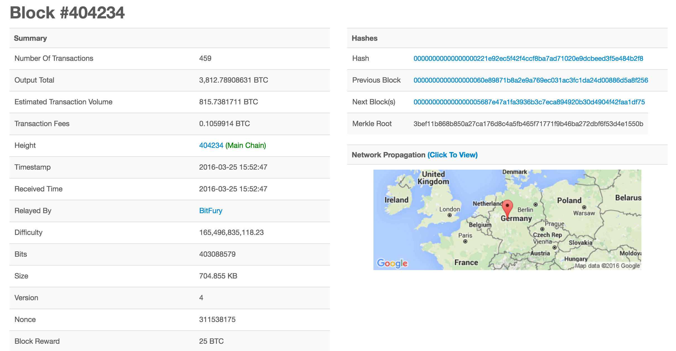
Anatomy of a Block
(from blockchain.info, a great resource for bitcoin info)

Slide 24
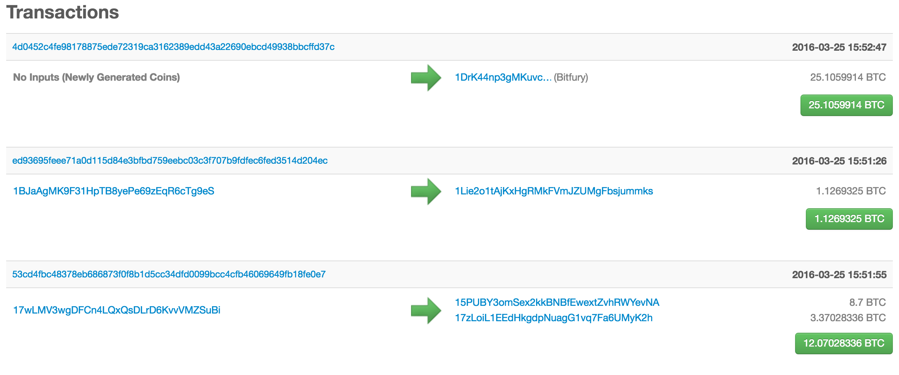
Block Transactions

Slide 25
Where are the rules?
The laws of Bitcoin (or any blockchain) are in the miner nodes
  Whatever 51% of the miners are running will win
The source to the node are the law
How do you change rules?
What happens if:
  The crypto breaks?
  We want to add more coins?
  We want to change the block format?

Slide 26
Attacks
What happens if the majority of the players defect?
  51% attacks – can extend bad blocks
How large a body needs to defect?
  Depending on network, can be 30% or less
  Sybil attacks

Slide 27
Operational Realities
Assumes cheap storage and networking
  Nodes store every transaction ever
  Transactions and blocks are broadcast
  Might limit scale...
Transactions are slow
  To verify a transaction, have to wait for a public block
Control of private keys is crucial
  Lose your private key = unspendable coins
  Steal your private key = steal coins
  Blacklisting keys breaks the game
    Builds a central control locus

Slide 28
Bitcoin Today
How much player power:
  Global hashing power just passed 1 Exahash/sec
  1,000,000,000,000,000,000 SHA-256 ops/sec
How many transactions:
  Approx 185,000 transactions / day
  About 383,000 BTC exchanged / day
1 BTC =~ $420 USD

Slide 29
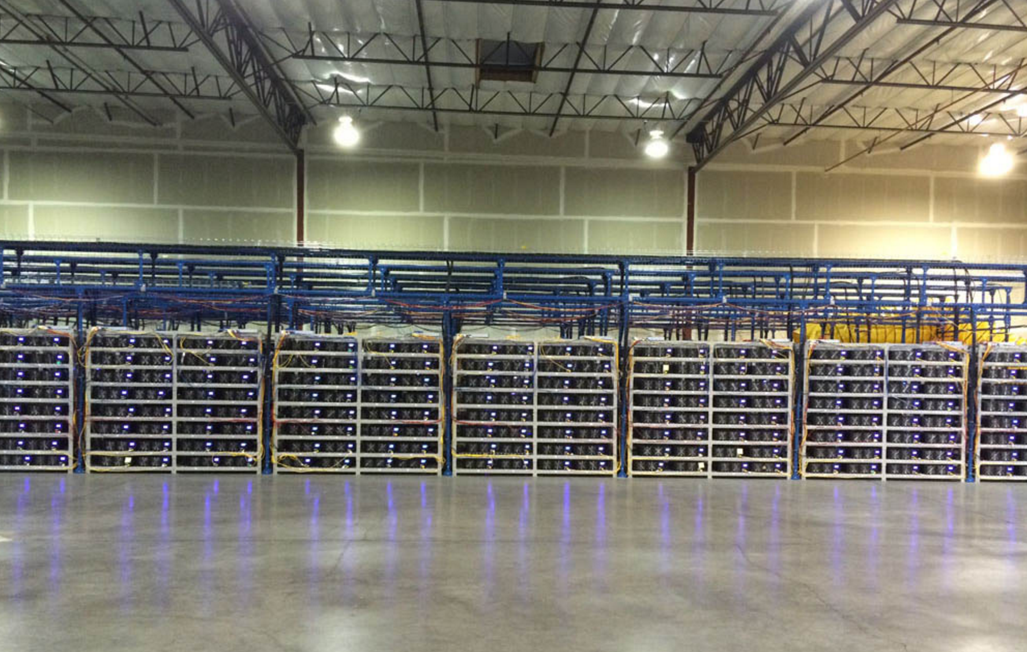
What a Petahash looks like
Hashnest.com

Slide 30
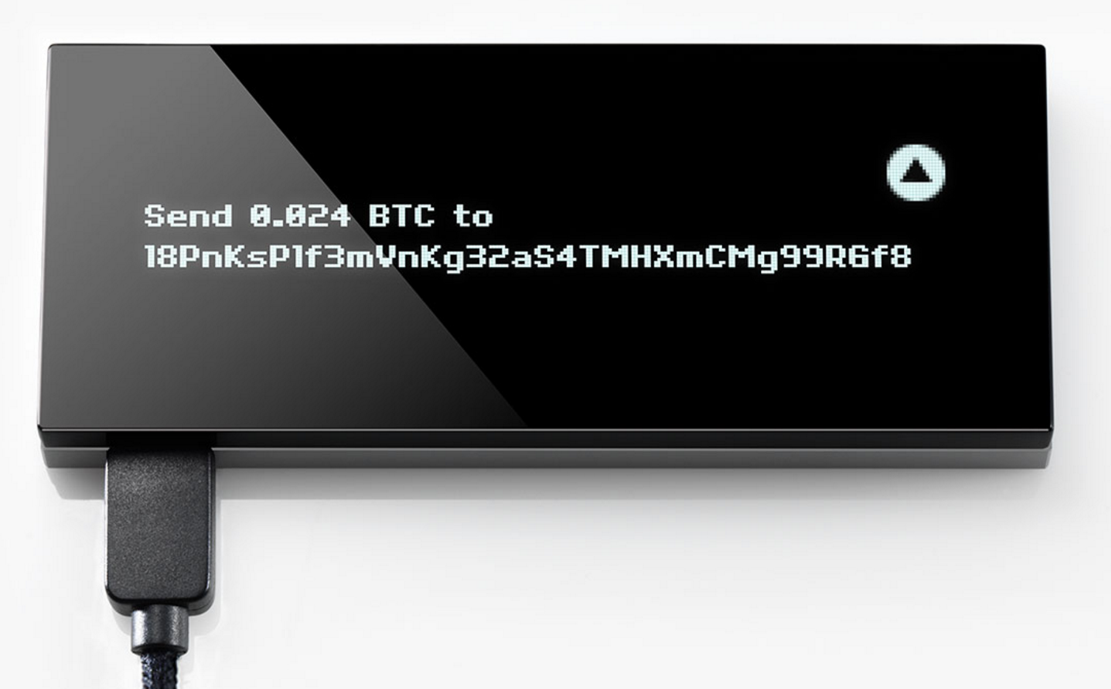
Hardware Cryptography?
Is there a place for secure hardware?
Keepkey.com

Slide 31
Beyond Bitcoin
Transactions don’t have to just be transactions
Transactions can contain:
  Executable code
    In fact, BTC transactions are scripts
    Scripts specify when outputs can be spent
  Contracts
    Set conditions for allowing outputs to move
  Random data to be timestamped
    “Colored coins” – add data to a transaction
    Transaction is recorded, so can be a hash of a document or other external data

Slide 32
Private Chains
Change the game to require signed blocks
Limit miners to some authorized set
Useful for adding other rules or preventing block “takeovers”
Approach being used to trade securities on a blockchain
Same crypto physics apply….

Slide 33
For More Information
Blockchain.info – a view onto the BTC chain
Ethereum.org – blockchain programming
Hyperledger.org – standards for blockchains
R3CEV.com – bank consortium for chains
Bank of England Distributed Ledgers
  http://www.bankofengland.co.uk/banknotes/Pages/digitalcurrencies/default.aspx

Slide 34
For a deeper understanding
Google “Princeton Bitcoin Book” – a free and excellent technical exploration of everything in this presentation
Associated Coursera course

